Slide 1
Project Presentation of CO-OP Project at Industry (Module-2)(22CS421)
On
LogLens-CLI: A Command-Line Tool for Analysis and Filtering of Structured Application Logs
Ansh Gupta 2210991295
Chirag 2210991460
Supervised By
Dr. Rajat Takkar
Mentor
Chitkara University
Department of Computer Science and Engineering,
Chitkara University, Punjab

Slide 2
The Problem We Noticed
When we were working on our own backend projects, logs became a real problem.
Whenever something broke, we had to open log files with thousands of lines. It was honestly very hard to find what actually went wrong.
We tried using tools like grep, but it only matches text. It does not understand log levels or timestamps.
Writing scripts again and again was slow and frustrating.
Tools like Winston and Morgan help in creating logs, but once logs are generated, they don’t help much in reading or filtering them.
So we thought — why not build something simple that solves this?
2

Slide 3

Objective of the Project
Our goal was very simple.
We wanted to make one small tool that developers can install once and use anytime whenever they want to check logs.
No setup, no UI, nothing complicated.
Just run a command and get the result.
We wanted it to:
Show only required logs like error, warning, info
Filter the logs by time range
Search using keywords
Print output clearly in terminal

Slide 4
System Overview
How LogLens-CLI works ?
At First, user runs a simple command like: loglens --file app.log --level error --from 14:00 --to 15:00
And then:
The file reader module opens that log file and then reads the file line by line
After that each line is parsed into a proper object
The filter engine module checks conditions like level, time or keyword
Finally, the logs which are matched will be shown to the terminal
We also added colors so it is easier for the user to read the output.

Slide 5
Methodology
We built the tool in parts instead of everything together.
Module | Job
File Reader | It checks the log file and gives error if that file is missing
Log Parser | It takes every row line and then parse it into the object
Filter Engine | It checks level, time and keyword conditions
Output Formatter | It shows the results in a clean, labelled and colored format
Each module was tested individually first and then connected.
This helped us to find bugs easily.
We used a modular approach because if we need to add new features later, we only need to change one part.
We tested using our own log files with different type of cases to make sure everything works properly.

Slide 6
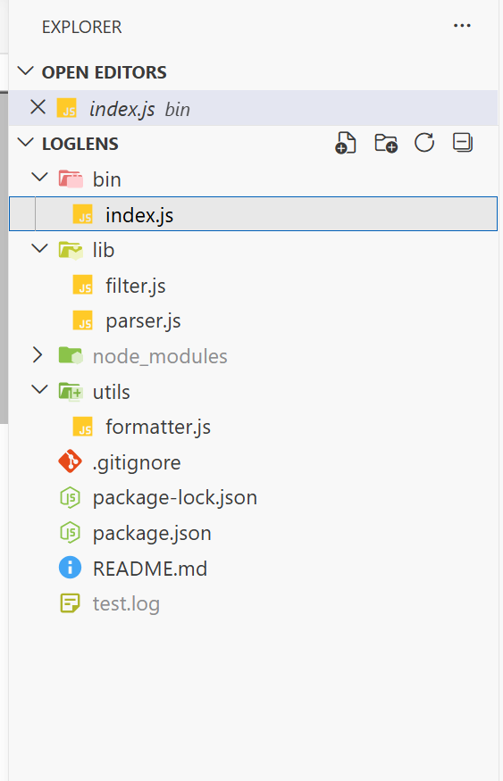

Slide 7
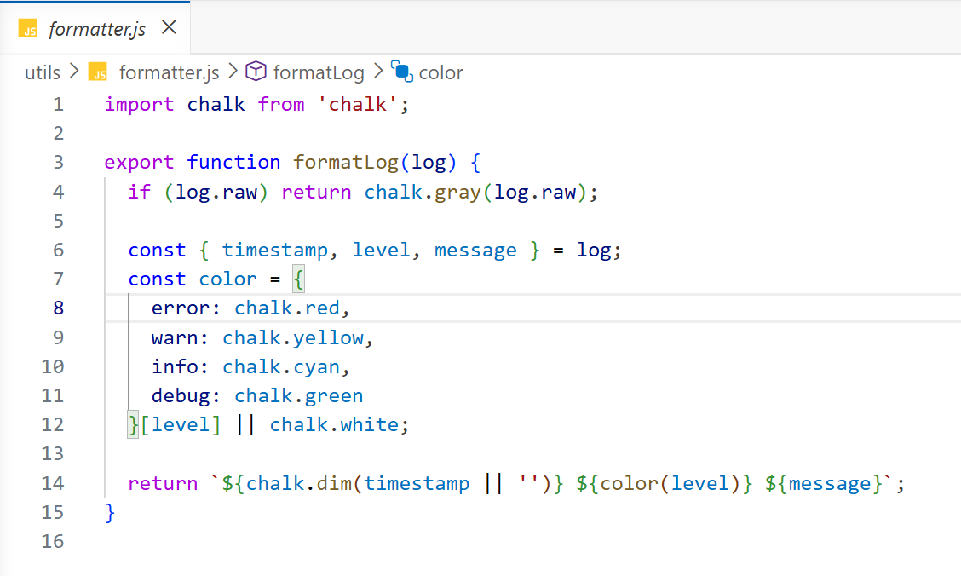

Slide 8
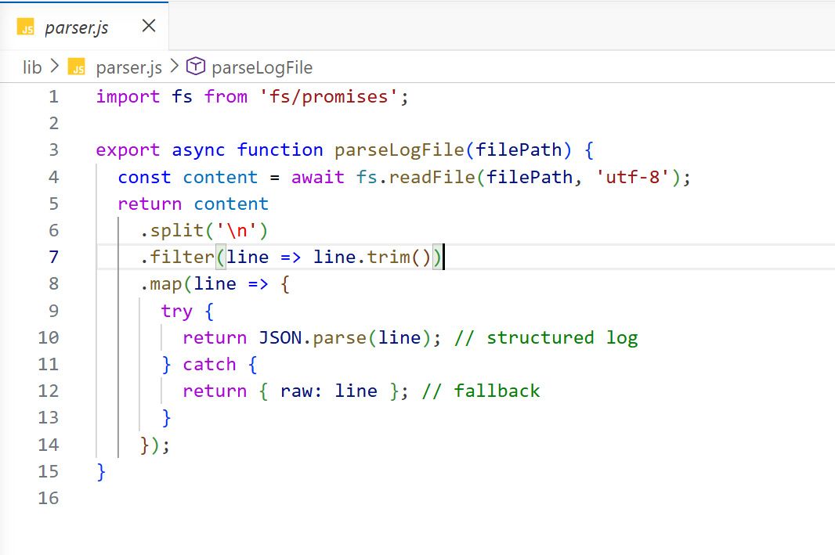

Slide 9
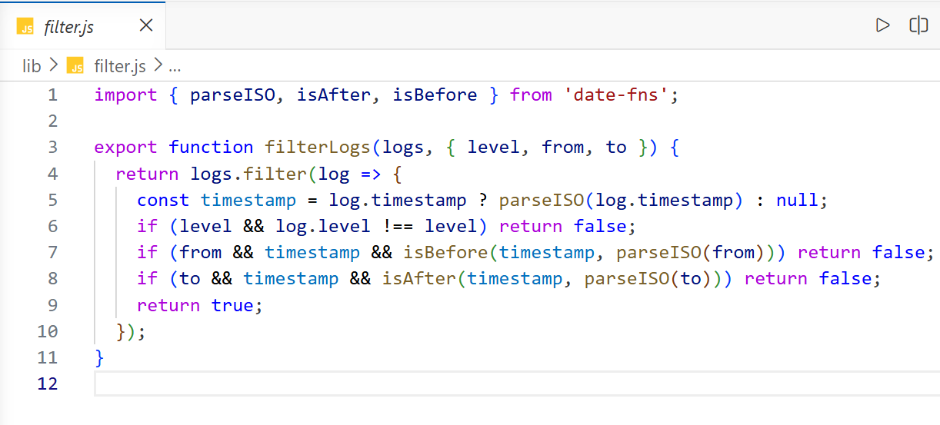

Slide 10

Key Features
Key Features of the tool :
Filter by log level You can see only errors or warnings when required
Time range filter Helps to directly jump to a specific time window
Keyword search Finds exact lines having that word you want
Works with large files Reads the line by line, so no memory issue
Easy installation Just one command and it works globally

Slide 11
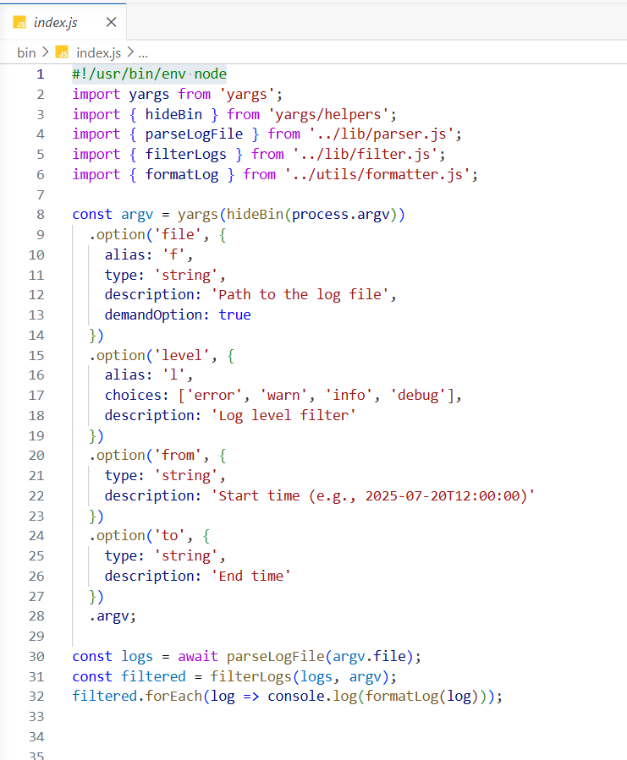

Slide 12
Technology Used
Technology | What we used it for | Why
Node.js | Running the tool | We both knew it well and it manages file reading nicely
JavaScript | Writing all the code | Our strongest language
fs module | Reading log files | Already built in Node, nothing extra to install
yargs | Handling CLI arguments | Simple to set up, clean syntax
JSON | Log file format | Easy to parse line by line
npm | Publishing the tool | Standard way to share Node tools globally

Slide 13
Key Outcomes
After testing, here is what we found:
A 10,000 line file was filtered in less than 1 second
All filters worked correctly in every test
A new user understood the tool in 2 minutes
Compared to grep, our tool was much easier for combined filtering
Keyword search gave correct results
So overall, the tool worked exactly how we expected.

Slide 14
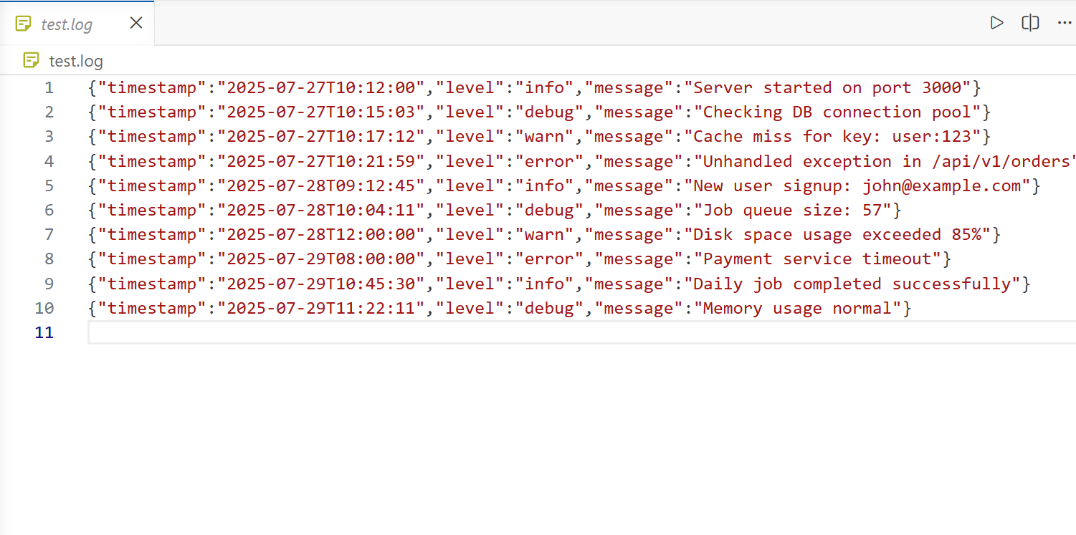

Slide 15
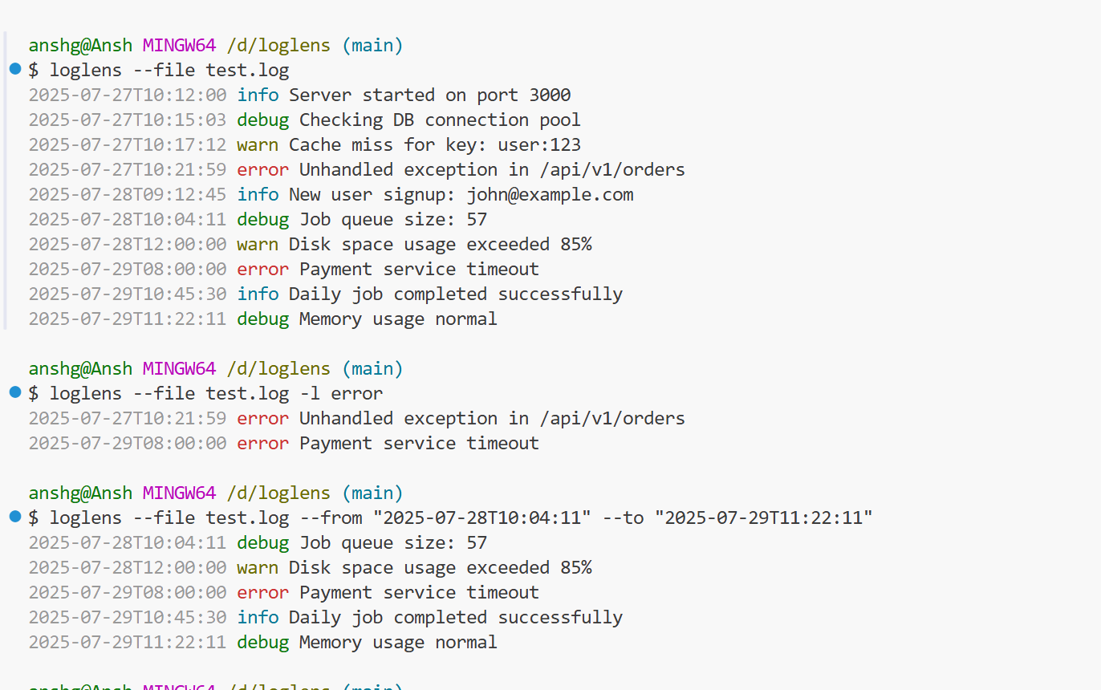

Slide 16
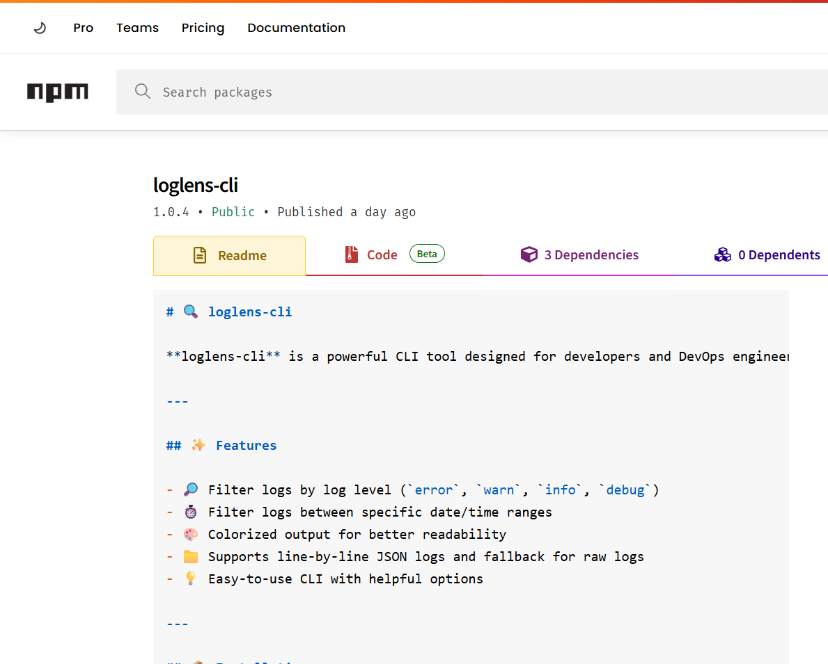
Conclusion
Our project came from a real problem we faced.
Logs were hard to read and took too much time.
So we made a simple CLI tool that solves this.
What we learned:
Building real tools is very different from
assignments
The modular design makes things easier
Importance of testing with real data
Publishing on npm was a great experience
And yes — we achieved our objective.

Slide 17
Future Scope
Right now it works for JSON logs
.
In future, we can add:
Soon:
Support for text and CSV logs
Better color formatting
Regex search
Later:
Multiple file support
Export results to file
Live log monitoring
Long term:
Integration with Grafana or ELK
Web dashboard
Custom plugins

Slide 18
References
Node.js Official Documentation — File System. https://nodejs.org/api/fs.html
npm — Creating and Publishing Packages. https://docs.npmjs.com
Minimist Library — Argument Parsing. https://www.npmjs.com/package/minimist
Winston Logger — Node.js Logging Library (studied for comparison). https://github.com/winstonjs/winston
Morgan — HTTP Request Logger Middleware (studied for comparison). https://www.npmjs.com/package/morgan
Chitkara University Project Guidelines, COOP-2, 2025–26

Slide 19
Thank You
19

